Slide 1
MongoDB Training
Nilap Shah
(MongoDB Certified DBA + Developer)
https://www.linkedin.com/in/nilap-shah-8b6780a/
Mobile : 9537047334 (WhatsApp)

Slide 2
Introduction
MongoDB is an open-source document database that provides high performance, high availability, and automatic scaling.
Features
High Performance (Embedded Model and Index)
Rich Query Language (CRUD, Aggregation and Text Search)
High Availability
Horizontal Scalability (Auto Sharding)
Supports multiple storage engine

Slide 3
MongoDB Developer Certification
Introduction (around 3 questions)
CRUD (Approx 20 questions)
Aggregation (Approx 10 Questions)
Schema Design (Approx 10 questions)
Indexes (Approx 10 Questions)
Replica set (5 Questions)
Sharding (5 Questions)

Slide 4
MongoDB DBA Certification
Introduction (around 3 questions)
CRUD (Approx 15 questions)
Aggregation (Approx 10 Questions)
Schema Design (Approx 5 questions)
Indexes (Approx 5 Questions)
Replica set (Approx 10 Questions)
Sharding (Approx 10 Questions)
Administration (Approx 10 Questions)

Slide 5
NOSQL - Types
Key Value Store (DynamoDB, Riak) – Big Hash Table
Document Based Data Store (MongoDB, CouchDB)
Column Based Data (Cassandra)
Graph Based (Neo 4J)

Slide 6
NOSQL
Key Value Store : Use associative array (dictionary / Map / Hashtable)
Document Store : JSON, BSON, XML
Column Based Data (Cassandra)
Graph Based : consisting number of elements interconnected with finite number of relations between them

Slide 7
Use Cases of MongoDB
Content Management Systems
Internet of Things
Real Time Analytics
Mobile Applications
Dynamics Webpages / Forms
Large Scale Social Media Websites
Video Sharing, Photo Sharing Portals
Many Other Applications

Slide 8
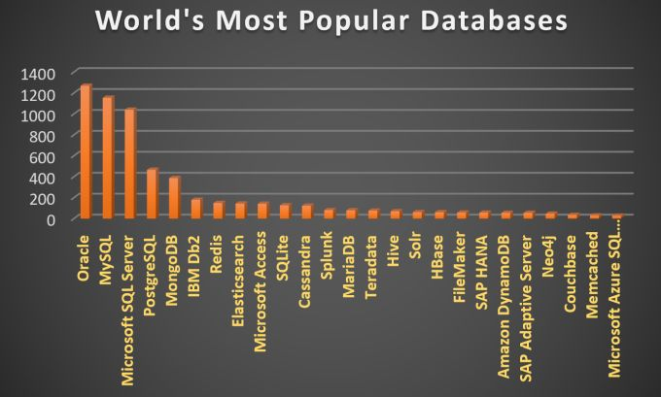
MongoDB Rank (World)

Slide 9
MongoDB
• Scalable High-Performance Open-source Document-orientated database.
• Built for Speed
• Rich Document based queries for Easy readability.
• Full Index Support for High Performance.
• Replication and Failover for High Availability.
• Auto Sharding for Easy Scalability.
• Map / Reduce for Aggregation.

Slide 10
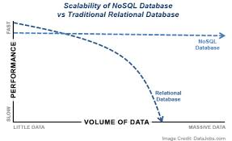
Great Divide
MongoDB - Sweet Spot: Easy, Flexible and Scalable

Slide 11
Why to use MongoDB ?
SQL was invented in the 70’s to store data.
MongoDB stores documents (or) objects
Now-a-days, everyone works with objects (Python/Ruby/Java/etc.)
And we need Databases to persist our objects. Then why not store objects directly ?
Embedded documents and arrays reduce need for joins. No Joins and No-multi document transactions(<MongoDB 4.0).

Slide 12
MongoDB Shell
Interactive JavaScript interface to MongoDB.
To query and update data as well as perform administrative operations
Connect to Mongo Shell
mongo --port 27017
Current database
db
Authenticate
use admin
db.auth(“username”,”password”)

Slide 13
MongoDB Shell
Show All Databases
admin 0.000GB
crud 0.000GB
db1 0.000GB
db2 0.000GB
local 0.000GB
training 0.000GB
Create/Use Database
use training
Show all collections
show collections

Slide 14
Datatypes MongoDB
null
boolean
number
string
date
regular expression
array
embedded document
object id

Slide 15
MongoDB ObjectID (Primary Key)
-Every document in collections contains by default _id field with type ObjectID
-Easy to generate and globally unique across all the machine
-It occupies 12 bytes storage
(0-3 bytes) --> Timestamp
(4-6 bytes) --> Machine
(7-8 bytes) --> PID
(9-11 bytes) --> Increment

Slide 16
SQL to MongoDB Comparison
SQL (Structured Query Language) | MongoDB
Database | Database
Table | Collection
Row | Document
Column | Field / Key
Index | Index
Table Join | $lookup + Embedded Document
Primary Key (Unique value in column) | _id is by default primary key

Slide 17
SQL to MongoDB Comparison
SQLs | MongoDB
Where | $match
GROUP BY | $group
HAVING | $match
SELECT | $project
ORDER BY | $sort
LIMIT | $limit
SUM() | $sum
COUNT() | $count
join | $lookup (Introduced in 3.2)

Slide 18
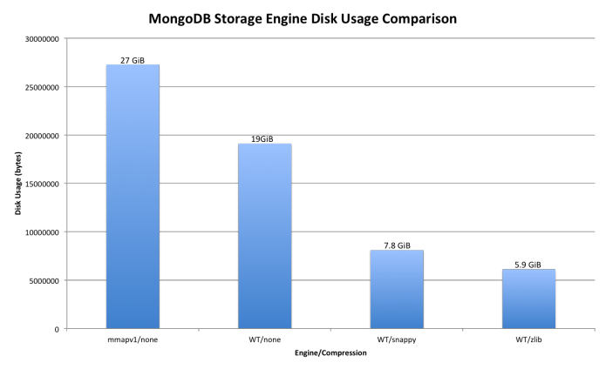
Sample Disk Usage

Slide 19
Performance Analysis of RDBMS
RDBMS having multiple Schema and each schema holds multiple tables to store data
MongoDB stores data in BSON it is similar like Json Data
MongoDB is almost 100 times faster than Traditional RDBMS
Easy to Scale and performance will remain consistent

Slide 20
CAP Theorem
-Consistent : It stores data in One or more members So it is Eventual Consistent
-Availability : It provides high availability through replica set.
-Partition Tolerance : There is no primary if 66% of servers are not available between multiple data Centre

Slide 21
ACID MongoDB 4.0
- Atomicity : all or nothing
- Consistent : all data stored in all majority nodes
- Isolation : all transactions are independent
- Durable : It does not provide durability by default

Slide 22
Base Principle of NoSQL
Basic Available : availability of data even if multiple failures because of highly distributed systems
Soft State : data consistency is developers problem It should not handled by database
Eventual consistency : MongoDB most of application writes data into majority of nodes
(By default w : 1)

Slide 23
Write Concern
Syntax : { w: <value>, j: <boolean>, wtimeout: <number> }
W : number of write operation propagated
W: 1 Default Instance
J: true → number of members written to disk journal
Wtimeout → miliseconds

Slide 24
linearizable"
Read Concern
Local (Replicaset Primary / Secondary)
Available (For Sharded Collections for low latency Read)
Majority : data stored in majority might acknowledged / might not acknowledged
Linerizable : query returns records only majority acknowledged before read operation starts
Snapshot : only available for multi document transactions. Majority + committed

Slide 25
Read Preference
Primary
Primary Preferred
Secondary
Secondary Preferred
Nearest

Slide 26
Storage Architecture
It is primary component of MongoDB responsible for managing data.
MongoDB Provides various storage engines
1)MMAPV1
2)Wiredtiger
3)In-Memory
Journaling:
It helps to recover data in case of hard shutdown
(In production we always use journaling)
GridFS:
To store large objects greater than 16 MB.

Slide 27
MMAPV1 Storage Engine
-It does not compress data
-MMAPv1 is MongoDB’s original storage engine based on memory mapped files.
-It immediately writes data to journal and every 60 seconds it will writes to data files so that’s why we called it as lazy writes.
-we can change the sync periods seconds
-it internally uses power 2 sized allocations so that every document is stored in a record space which contains itself and extra space.
-it reduce moves and in place updates are very fast.
-it will do memory management automatically.

Slide 28

MMAPV1 Storage Engine

Slide 29

MMAPV1 Storage Engine

Slide 30

MMAPV1 Storage Engine

Slide 31
WiredTiger Storage Engine
Default (if you do not specify in config file)
It supports only 64 bit machines only
Document level Concurrency (Optimistic Concurrency)
(still it blocks instance while creating db, creating collection)
(Any conflict between two operations it will retry the operation)
Check pointing Mechanism to store the data (consistent view)
default it is using snappy compression technique (snappy / zlib)
If we want to optimize the performance of wiredtiger ??
Why Journaling is required for wired tiger storage engine
Wired tiger cache = (50% of RAM – 1 GB)
Compression can be configurable at collection level

Slide 32
WiredTiger Storage Engine

Slide 33
In Memory Storage Engine
From MongoDB 3.2.6 is not part of general availability in 64 bit only
It does not persist any data any disk data, configuration data, indexes And user credentials etc.
It provides document level concurrency for write operations
It maintains application data, oplog data and indexes in RAM only
whenever it exceeds the size of RAM it will generate an error
we are not using journaling while using In-Memory Storage Engine.
how can we persist data for this kind of deployment (replicaset or sharding)
Use Cases

Slide 34
Journaling in WiredTiger
Journaling in WiredTiger Storage Engine
It uses checkpoint mechanism. It writes data immediately to Journal & it makes checkpoint at certain interval
Whenever any power failture occurs & when machine recovers from it. It will check the last checkpoint from data files
It will also check journaling and it will apply the operations from last checkpoints
WiredTiger preallocates space for Journaling with WiredTigerLog.<sequence>
Internally it contains unique identifier for each record
It uses snappy compression technique. It will not compress the record if record size less than 128 bytes
Maximum file size of journaling is 100 MB.
It automatically remove journal files which is not needed
Check point will occur at every 60 seconds or 2 GB of data

Slide 35
Journaling in WiredTiger
When a write operation occurs, MongoDB updates the in-memory view
MongoDB writes the in-memory changes first to on-disk journal files
If MongoDB should terminate or encounter an error before committing the changes to the data files, MongoDB can use the journal files to apply the write operation to the data files and maintain a consistent state.
It maintains two views private view and shared view.
First it applies operations private view and it applies to on disk journal files and copies data to shared view. It occurs at every 100 ms
Finally mongodb applies that operations to data files. By default this occurs at every 60 seconds

Slide 36
CRUD Operations
Insert Document
Syntax: db.collection.insertOne()
Example:
db.inventory.insertOne( { item: "canvas", qty: 100, tags: ["cotton"], size: { h: 28, w: 35.5, uom: "cm" } } )
Retrieve document:
Syntax: db.collection.find()
db.inventory.find({"item" : "canvas"});

Slide 37
CRUD Operations
Insert Many Documents
Syntax: db.collection.insertMany()
Example:
db.inventory.insertMany(
[ { item: "journal", qty: 25, tags: ["blank", "red"], size: { h: 14, w: 21, uom: "cm" } },
{ item: "mat", qty: 85, tags: ["gray"], size: { h: 27.9, w: 35.5, uom: "cm" } },
{ item: "mousepad", qty: 25, tags: ["gel", "blue"], size: { h: 19, w: 22.85, uom: "cm" } } ])

Slide 38
CRUD Operations
Update Single Document
Syntax: db.collection.updateOne(
<filter>,
<update>,
{ upsert: <boolean>,
writeConcern: <document>,
collation: <document> } )
Example:
db.restaurant.updateOne(
{"name":"Central Perk Cafe"},
{$set:{"violations":3}});

Slide 39
CRUD Operations
Update Single Document with upsert
db.restaurant.updateOne(
{ "name" : "Pizza Rat's Pizzaria" },
{ $set: {"_id" : 4, "violations" : 7, "borough" : "Manhattan" } },
{ upsert: true } );
Result : ??
db.restaurant.updateOne(
{ "violations" : { $gt: 10} },
{ $set: { "Closed" : true } },
{ upsert: true } );
Result : ??

Slide 40
CRUD Operations
Update Single Document with writeconcern
Syntax:
db.restaurant.updateOne(
{ "name" : "Pizza Rat's Pizzaria" },
{ $inc: { "violations" : 3}, $set: { "Closed" : true } },
{ w: "majority", wtimeout: 100 });

Slide 41
CRUD Operations
Update Many (Refresh Restaurant Collection)
Syntax: same as single update
db.restaurant.updateMany( { violations: { $gt: 4 } }, { $set: { "Review" : true } } );
Result: ??
db.inspectors.updateMany( { "Sector" : { $gt : 4 }, "inspector" : "R. Coltrane" }, { $set: { "Patrolling" : false } }, { upsert: true } );
Result: ??

Slide 42
CRUD Operations
$set,$unset,$inc
$set: db.inspectors.update({"_id":92413},{$set:{x:1}});
db.testembedded.insert({x:1,"address":city:"ahmedabad",
Pin:38007}});
$set with Embedded Document
db.testembedded.update({x:1},{$set:{"address.city":"banglore"}});
$inc
db.testembedded.update({"_id": ObjectId("59764c2d57d3e824bb31bcfe")},{$inc:{x:5}});
You can do it same thing for an array as well

Slide 43
CRUD Operations
$push
db.blog.posts.insertOne({"title" : "A blog post","content" : "blog content"});
db.blog.posts.updateOne({"title" : "A blog post"},{"$push":{"comments":{"name":"joe", "email":"joe@example.com", "content" : "nice post."}}})
db.blog.posts.updateOne({"title" : "A blog post"},{"$push":{"comments"{"name":"prabhu","email":"prabhu@nuware.com","content" : "super post."}}})

Slide 44
CRUD Operations
$each – multiple subdocuments with push
db.blog.posts.updateOne({"title" : "A blog post"},{"$push":{"comments":
{$each:[
{"name":"vijay","email":"vijay@nuware.com","content" : "vijay post."},
{"name":"chetan","email":"chetan@nuware.com","content" : "chetan post."}
]}
}})

Slide 45
CRUD Operations
$slice – limit number of elements
db.blog.posts.updateOne({"title" : "A blog post"},{"$push":{"comments":
{$each:[
{"name":"new1","email":"vijay@nuware.com","content" : "vijay post."},
{"name":"new2","email":"chetan@nuware.com","content" : "chetan post."}
],
$slice:-3,
$sort:{name:1}
}
}})

Slide 46
CRUD Operations
$addToSet
db.users.insert({"name":"prabhu", emails:"prabhu@nuware.com"]});
db.users.updateOne({"name":"prabhu"}, {$push:{emails:"prabhu@gmail.com"}});
db.users.updateOne({"name":"prabhu"}, {$push:{emails:"chetan@gmail.com"}});
db.users.updateOne({"name":"prabhu"}, {$addToSet:{emails:"prabhu@gmail.com"}});

Slide 47
CRUD Operations
ReplaceOne Document
Syntax:
db.collection.replaceOne(
<filter>,
<replacement>,
{ upsert: <boolean>,
writeConcern: <document>,
collation: <document> } )
Example: db.inspectors.replaceOne({"inspector" : "F. Drebin"},{x:1});

Slide 48
CRUD Operations
Remove
Syntax: db.collection.remove({filter:});
Example:
db.test.remove({x:5});
db.test.remove({});
Result: ??

Slide 49
Nilap Shah (MongoDB Trainer)
Location : Banglore
Linked in Profile (Mobile-9537047334)
https://www.linkedin.com/in/nilap-shah-8b6780a/

